Slide 1
GPS Project
Presentation
- Goal Tracker
Gabriel Losada - 2023109148
Pedro Paiva - 2021134625
Tomás Ferreira - 2021130424
João Carvalho - 2019131769
Eliza Czaplicka - 2022110771

Slide 2
Index
Introduction with project goals, vision and team members
Product - planned + delivered, per sprint: Goals/increments, User Stories
Project management - project lifecycle, sprints, releases, budget and effort per sprint and per release, project control, etc.
Risk plan and evolution, Threshold of Success whether it has been reached
Quality - unit tests, integration tests and acceptance tests that were done or not
DevOps - Git Workflow, CI/CD pipeline that was done or not
Global analysis and conclusions
Lessons learned
Individual analysis and conclusions (1 slide per team member)
main individual contributions during the project
participation on the team results
perception of the team performance

Slide 3

Introduction
In a world full of challenges, our project brings a solution. We've made an app to help users set and handle daily, weekly, and monthly goals, highlighting the importance of forming positive habits for personal growth.
Our goal is to inspire users to achieve doable goals, make positive changes, and feel good about themselves. This friendly app is here to assist everyone on their journey to self-improvement.

Slide 4
2. Product
Sprint 1
Basic GUI
Adding and listing tasks
Adding all task inputs
Setting tasks to daily/weekly/monthly
Sprint 2
Finishing tasks from sprint 1
Setting tasks for a specific day
Improving GUI
Sprint 3
Streaks and achievements
Reminders
Doing tasks multiple times a day
Improving GUI

Slide 5
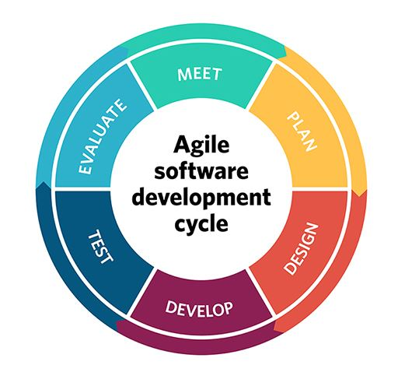
3. Project management
The project was structured into multiple sprints, each with specific goals and tasks. The lifecycle followed the agile methodology, allowing for iterative development and regular feedback.
Sprint 1: Estimated 29.5 hours, actual 19.5 hours.
Sprint 2: Estimated 36.6 hours, actual 28.6 hours.
Sprint 3: Estimated 64 hours, actual 57.7 hours.
Release 1 (MVP) and Release 2
Regular Sprint Reviews, ensured the project was on track and adjustments were made as necessary.

Slide 6
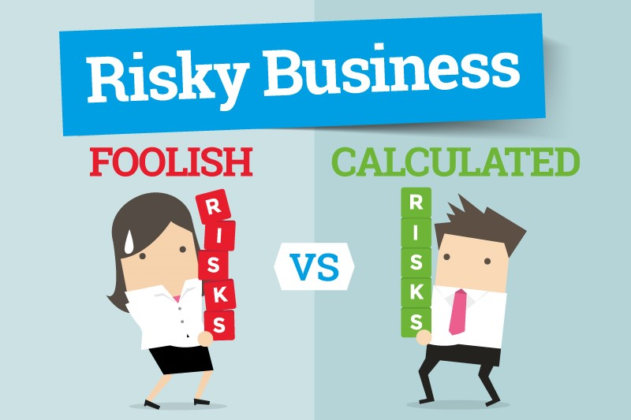
4. Risk plan and evolution
In our risk plan, success was defined by achieving "must" user stories, equal team contributions, and overall satisfaction. Anticipated risks included project management issues, code quality concerns, and potential integration issues.
After completing the project we successfully developed all "must" user stories, with contributions distributed reasonably evenly and despite not achieving perfection, we are overall satisfied with the final result, having effectively overcome anticipated challenges.

Slide 7
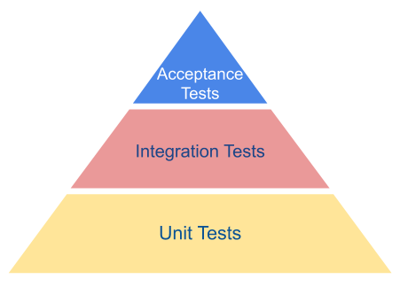
5. Quality
Unit Tests:
Some unit tests were created but are not running optimally, as they are not automatically executed with each commit.
Impact: The absence of unit tests can increase the risk of bugs in individual components of the code.
Acceptance Tests:
Manual testing, focused on validating the app’s functionality against user requirements;
All acceptance tests were successfully carried out;
The acceptance tests ensured that the implemented functionalities aligned with the expectations and requirements of the end-users.

Slide 8
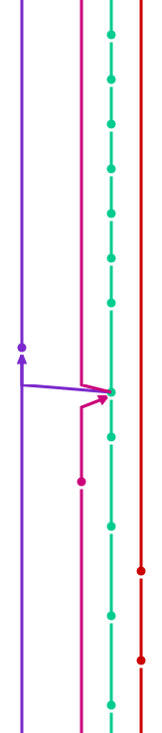
6. DevOps - Git Workflow, CI/CD pipeline
teal - dev
purple - qa
other - personal branches
Basically, each team member worked on their own branch, pushed changes to the dev branch, resolved conflicts with other teammates, and then performed a merge to the qa branch.

Slide 9
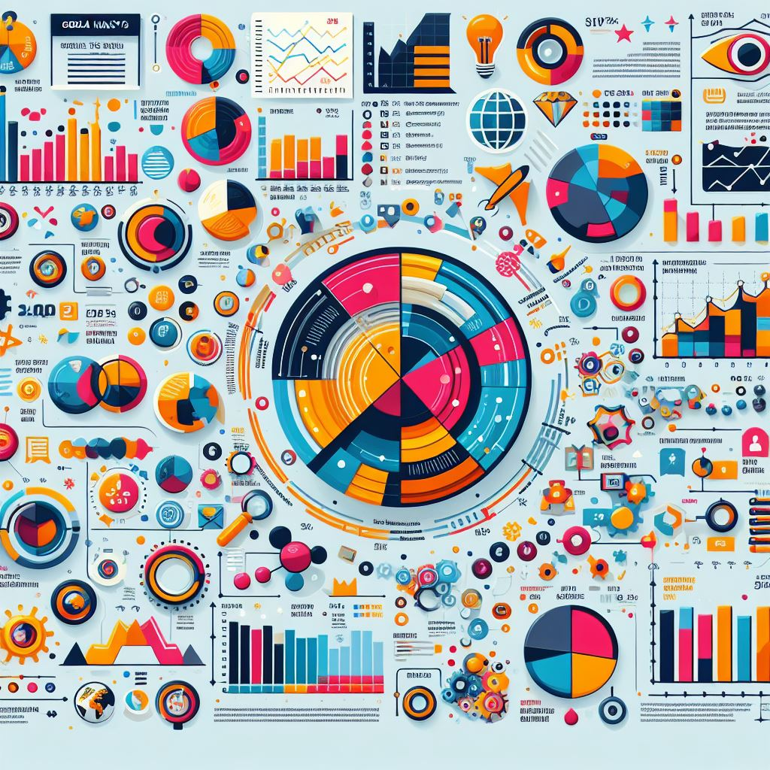
7. Global analysis and conclusions
-The project didn’t start well in the first sprint, after that , the project advanced and evolved considerably.
-The project was a success due to:
The problem that the team proposed is fixed due to the creation of the application.
The final product has been delivered on time.
All of the requirements have been met.
Almost all problems and setbacks have been solved (errors, bugs…) apart from multiple tasks US.
- These challenges have served to learn and improve.
-It helped to gain experience with these types of projects

Slide 10

8. Lessons learned
-The need for more detailed user stories.
-How to communicate between the group and help each other in different tasks.
-Agile methodologies enable adaptability to changing requirements.
-The use of gitlab and the other used platforms.
-Documentation is essential to follow a good path in the project and have a good base for future changes.

Slide 11
Individual Analysis

Slide 12
Tomás
Main individual contributions during the project:
Implementing reminders to the tasks, Achievements.
Participation on the team results:
I actively participated by providing feedback, particularly in areas related to user experience and interface design.
Perception of the team performance:
The project began with some difficulties, but as we progressed, we saw an improvement, largely due to the collective contributions of the entire team.

Slide 13
Pedro
Main individual contributions during the project
Helped with the project's user interface design.
Built features like task details, undo, and delete.
Assisted in developing different parts of the project.
Always available for testing and assisting teammates.
Participation on the team results
Provided consistent feedback, opinions, and hands-on support during testing.
Played a key role in enhancing the project's user interface design.
Perception of the team performance
We had a rough start, but everyone put in a lot of effort to get things on the right track.

Slide 14
João
Main individual contributions during the project
Managing the repository, handling CI/CD pipeline.
Helping teammates with coding, because they were less experienced in Java.
Handled the biggest part of project structure, code wise.
Solving bugs.
Participation on the team results
Big influence on the teams evolution.
Perception of the team performance
The team evolved quite well.
Started with the wrong foot, but everyone worked hard to make things go the right direction.

Slide 15
Gabriel
Main individual contributions during the project :
Build scenes to the application.
Help the teammates with tasks or advices…
Help to the evolution of the project.
Participation on the team results
Validation and communication to improve the result.
Perception of the team performance :
There were difficulties in communication at the beginning.
In the sprint two, there was a important evolution on the team and the project.
It solves the problem that it was proposed.

Slide 16

Eliza

Slide 17
Thank you
for your attention

